Slide 1

HOSPITAL MANAGEMENT SYSTEM Project Mentor: Ms.Samruddhi Phadnis Mr.Pratik Ninganur

Slide 2
PURPOSE
The purpose of this project is to automate or make online, the process of day to-day activities like Room activities; Admission of New Patient, Discharge of Patient, Assign a Doctor, and finally compute the bill etc.

Slide 3
SCOPE OF HMS
To keep track of hospital’s day to day activities & record of its patients, doctors that keep the hospital running smoothly & successfully.
To digitalise all the versions of the manual system.
To provide a paper-less hospital up to 90% i.e. To provide low-cost reliable digitalization of the existing systems.
To digitalise the process like Getting the appointment, Registering the new patient, Assigning the doctor, Adding new employee as well as Computing the bill etc.
To provide excellent security of data at entry level of user system interaction and also to provide robust and reliable facility to patient.

Slide 4
BENEFITS OF HMS
Streamlined operations
Enhanced administration control
Superior patient care
Strict cost control
Improved profitability

Slide 5
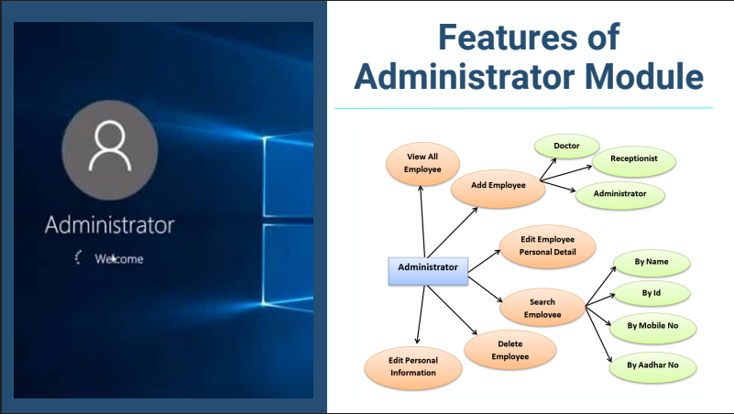

Slide 6
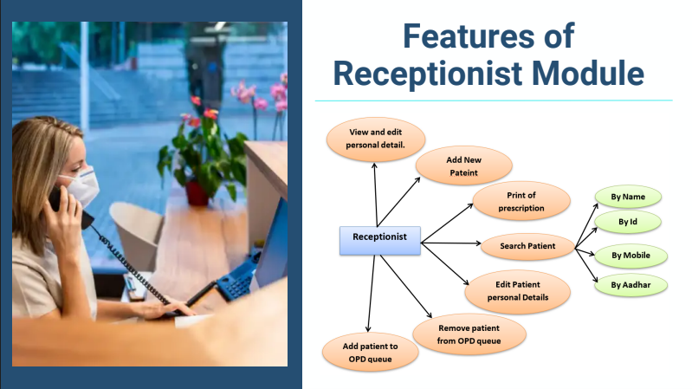

Slide 7
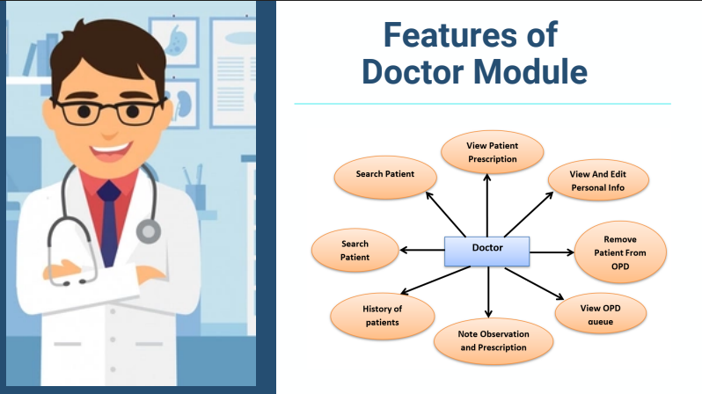

Slide 8
THANK YOU

